Slide 1
Lecture 07
Oral and interpersonal communication

Slide 2
Oral communication
You will spend more time talking than writing in business.
Most of your oral communication will be informal.
But some of it will be formal, as in meetings, phone calls, dictation, speeches, and oral reports.
This and the following lecture cover these types of oral communication.

Slide 3
Oral communication
Most of us do a reasonably good job of informal talking.
In fact, we do such a good job that we often take talking for granted and overlook the need for improving our talking ability.
To improve our talking, we need to be aware of its nature and qualities. Then we need to work to overcome our shortcomings.
Think about the best and worst speakers you can imagine. This contrast should give you the qualities of good talking: voice quality, speaking style, word choice, adaptation.

Slide 4
Oral communication
Voice quality - Good voice quality helps one communicate. It involves pitch, delivery speed, and volume.
Study the quality of your voice and compare it with what experience tells you is good.
For example, You know the effect of talking that is too fast or too slow, talking in a monotone, in a high-pitched voice, a guttural voice, a monotone voice, etc.
With this knowledge in mind, you should analyze your own voice, perhaps with the assistance of a recorder. Listen carefully to yourself. Then make a conscious effort to improve what you hear.

Slide 5
Oral communication
Style - Style refers to a set of voice behaviors that give each person a unique voice. It is the way that pitch, speed, and volume combine to give personality to one’s oral expression.
From the self-analysis described previously, you also should have a good idea of your talking style.
What is the image your talking projects? Does it project sincerity? Is it polished? Smooth? Rough? Dull? After your honest assessment, you should be able to determine your style deficiencies so that you can improve.

Slide 6
Oral communication
Word Choice - Choose words that you know your audience will understand. I.e., make sure that your choice of words are not too difficult or too easy for your audience.
Select those that appropriately convey courtesy and respect for the listener’s knowledge.
Consider, too, that the vocabulary you use with your friends outside the workplace may not be professionally appropriate for use in the workplace—no matter how friendly you are with your co-workers, superiors, or subordinates.

Slide 7
Oral communication
Adaptation - Adaptation is fitting the message to the listener.
It includes word selection, but here we refer to the combined effect of words, voice, and style.
To illustrate, the voice, style, and words in an oral message aimed at children would be different for the same message aimed at adults.

Slide 8
Meetings

Slide 9
Meetings
Conduction and participating in meetings From time to time, you will participate in business meetings.
These will range from extreme formality to extreme informality.
On the formal end will be conferences and committee meetings, while discussions with groups of fellow workers will be at the informal end.
Whether formal or informal, the meetings will obviously involve communication, and the quality of the communication will determine their success.

Slide 10
Meetings
How you conduct a meeting depends on the formality of the occasion.
Meetings of such groups as formal committees, boards of directors, and professional organizations usually follow generally accepted rules of conduct called parliamentary procedure.
These very specific rules are too detailed for review here. When you are involved in a formal meeting, you would do well to study one of the many books covering parliamentary procedure before the meeting so that you know, for example, what it means to make a motion or call for a vote.

Slide 11
Conducting a meeting
1. Plan the items to be covered - A key to conducting a successful meeting is to plan it thoroughly.
That is, you develop an agenda, a list of topics to be covered to achieve the goals of the meeting.
Then arrange these items in the most logical order. Items that explain or lead to other items should come before the items that they explain or lead to.
After preparing the agenda, make it available to those who will attend.
For informal meetings, you may find having a mental agenda satisfactory.

Slide 12
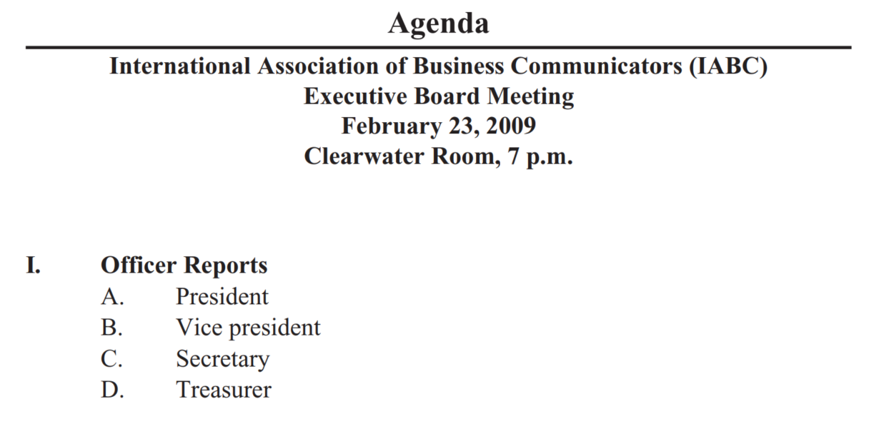
Sample agenda
1. Plan the items to be covered - A key to conducting a successful meeting is to plan it thoroughly.
That is, you develop an agenda, a list of topics to be covered to achieve the goals of the meeting.
Then arrange these items in the most logical order. Items that explain or lead to other items should come before the items that they explain or lead to.
After preparing the agenda, make it available to those who will attend.
For informal meetings, you may find having a mental agenda satisfactory.

Slide 13
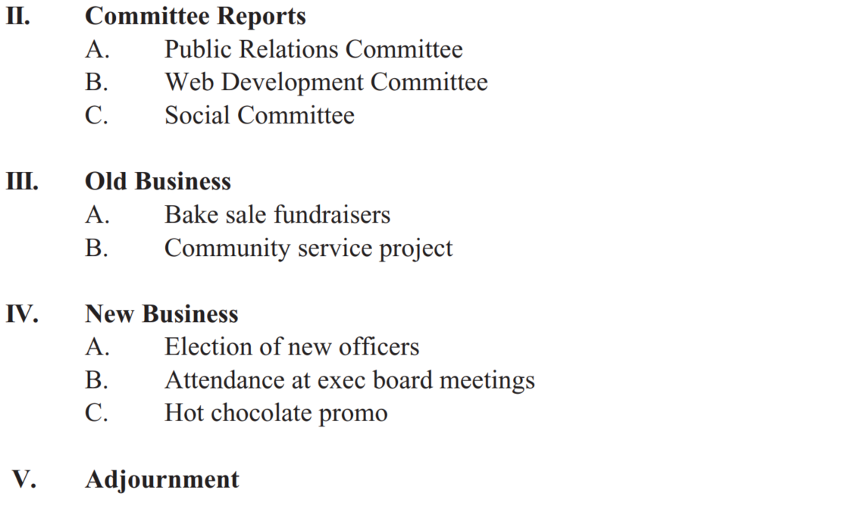
Conducting a meeting
1. Plan the items to be covered - A key to conducting a successful meeting is to plan it thoroughly.
That is, you develop an agenda, a list of topics to be covered to achieve the goals of the meeting.
Then arrange these items in the most logical order. Items that explain or lead to other items should come before the items that they explain or lead to.
After preparing the agenda, make it available to those who will attend.
For informal meetings, you may find having a mental agenda satisfactory.

Slide 14
Conducting a meeting
2. Follow the Plan - You should follow the plan for the meeting item by item. In most meetings the discussion tends to stray and new items tend to come up.
As leader, you should keep the discussion on track. If new items come up during the meeting, you can take them up at the end or perhaps postpone them for a future meeting.
3. Move the Discussion Along - As leader, you should control the agenda. After one item has been covered, bring up the next item.
Your goal is to permit complete discussion on the one hand and to avoid repetition, excessive details, and off-topic comments on the other.

Slide 15
Conducting a meeting
4. Control Those Who Talk Too Much - A few people usually tend to dominate the discussion.
Of course, you will need to let these people talk as long as they are contributing to the goals of the meeting.
However, when they begin to stray, duplicate, or bring in irrelevant matter, you should step in.
You can do this tactfully by asking for other viewpoints or by summarizing the discussion and moving on to the next topic.

Slide 16
Conducting a meeting
5. Encourage Participation from Those Who Talk Too Little -
Just as some people talk too much, some talk too little. Your job as leader is to encourage these people to participate by asking them for their viewpoints and by showing respect for the comments they make.
6. Control Time - When your meeting time is limited, you need to determine in advance how much time will be needed to cover each item.
Then, at the appropriate times, you should end discussion of the items.

Slide 17
Conducting a meeting
7. Summarize at Appropriate Places - After a key item has been discussed, you should summarize what the group has covered and concluded.
8. Take Minutes - What is said and what is heard in a meeting may not be remembered consistently by participants.
To ensure you have an accurate, objective account of the topics covered and decisions made at a meeting, assign the task of recording the meeting events (taking minutes) to someone.

Slide 18
Conducting a meeting
Minutes can be written many ways. For example, If there is an agenda, the minutes will usually summarize the discussion of each agenda topic.
Regardless of their format, the minutes must be accurate and reliable.
Sample minutes -

Slide 19
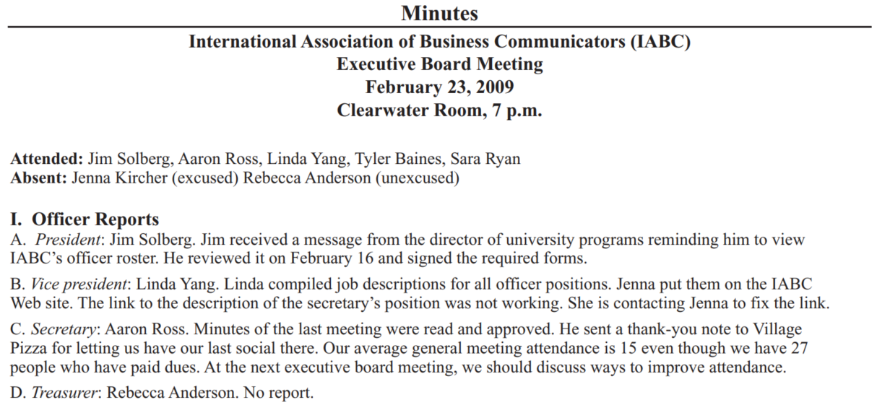
Conducting a meeting
Minutes can be written many ways. For example, If there is an agenda, the minutes will usually summarize the discussion of each agenda topic.
Regardless of their format, the minutes must be accurate and reliable.

Slide 20
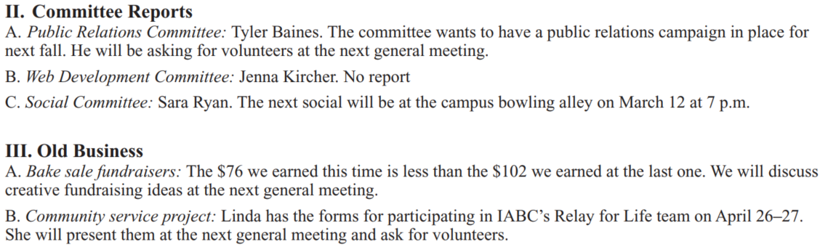
Sample minutes
Minutes can be written many ways. For example, If there is an agenda, the minutes will usually summarize the discussion of each agenda topic.
Regardless of their format, the minutes must be accurate and reliable.

Slide 21
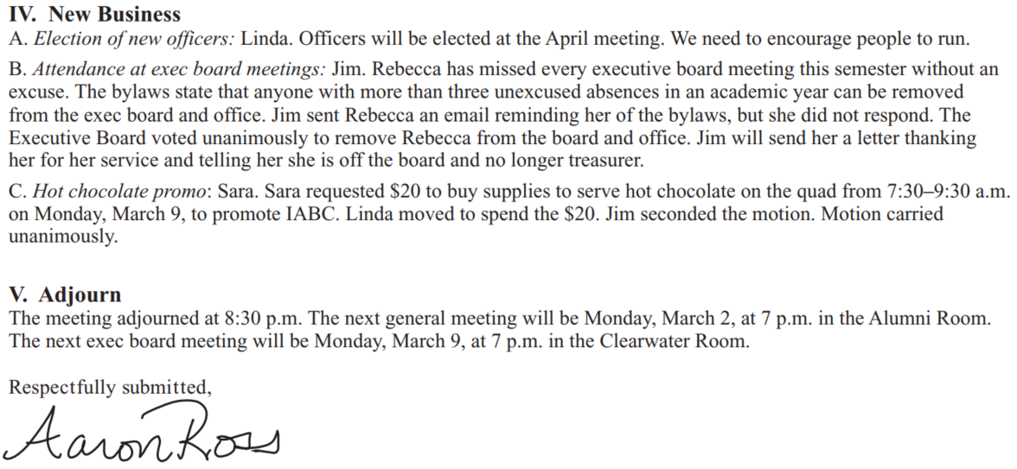
Sample minutes
Minutes can be written many ways. For example, If there is an agenda, the minutes will usually summarize the discussion of each agenda topic.
Regardless of their format, the minutes must be accurate and reliable.

Slide 22
Participating in a meeting

Slide 23
Participating in meetings
From the preceding discussion of the techniques that a leader should use, you can infer some of the things that a participant should do.
Follow the Agenda. When an agenda exists, you should follow it.
Specifically, you should not bring up items not on the agenda or comment on such items if others bring them up.
When there is no agenda, you should stay within the general limits of the goal for the meeting.

Slide 24
Participating in meetings
2. Participate. The purpose of meetings is to get the input of everybody concerned. Thus, you should participate.
Your participation, however, should be meaningful. You should talk only when you have something to contribute
3. Do Not Talk Too Much. As you participate in the meeting, be aware that other people are attending.
You should speak up whenever you have something to say, but do not get carried away. As in all matters of etiquette, always respect the rights of others

Slide 25
Participating in meetings
4. Cooperate. A meeting by its very nature requires cooperation from all the participants.
Respect the leader and her or his efforts to make progress.
5. Be Courteous. Perhaps being courteous is a part of being cooperative.
In any event, you should be courteous to the other group members.
Specifically, you should respect their rights and opinions, and you should permit them to speak.

Slide 26
Using the phone

Slide 27
Using the phone
At first thought, a discussion of business phone techniques may appear to be unnecessary.
After all, most of us have had long experience in using the phone and may feel that we have little to learn about it.
No doubt, some of us have excellent phone skills.
But you have only to call a few randomly selected businesses to learn that not everyone who talks on the phone does so proficiently.

Slide 28
Using the phone
You will get some gruff, cold greetings, and you will be subjected to a variety of discourtesies. And you will find instances of inefficient use of time (which, of course, is costly).
Professional Voice Quality - In reviewing good phone techniques, keep in mind that a phone conversation is a unique form of oral communication.
Only voices are heard; the speakers are not seen. Impressions are received only from the words and the quality of the voices.
Thus, when speaking by phone, you must work to make your voice sound pleasant and friendly.

Slide 29
Using the phone
One often-suggested way of improving your phone voice is to talk as if you were face-to-face with the other person—even smiling and gesturing as you talk if this helps you be more natural.
Perhaps the best advice is to record one of your phone conversations.
Then judge for yourself how you come across and what you need to do to improve.

Slide 30
Using the phone
Courtesy - Be courteous.
The recommended procedure when you are calling is to introduce yourself immediately and then to ask for the person with whom you want to talk:
“This is Wanda Tidwell of Tioga Milling Company. May I speak with Mr. José Martinez?”
If you are not certain with whom you should talk, explain the purpose of your call:
“This is Wanda Tidwell of Tioga Milling Company. We have a question about your service warranty. May I speak with someone who can help me?”

Slide 31
Using the phone
When an administrative assistant or someone else who is screening calls answers the phone, the recommended procedure is to first identify the company or office and then to offer assistance:
“Rowan Insurance Company. How may I help you?”
“Ms. Santo’s office. May I help you?”
When a call goes directly into the office of the executive, the procedure is much the same, except that the executive identifies herself or himself:
“Bartosh Realty. Toby Bartosh speaking. May I help you?”

Slide 32
Using the phone
Special care should be taken not to offend the caller.
Following a question like “Who is calling?” by “I am sorry, but Mr. Gordon is not in” leaves the impression that Gordon may be in but does not want to talk with this particular caller.
A better procedure would be to state directly “Mr. Gordon is not in right now. May I ask him to return your call?” Or perhaps “May I tell him who called?”

Slide 33
Effective voicemail technique

Slide 34
Voicemails
Sometimes when the person you are calling is not available, you will be able to leave a voice message in an electronic voice mailbox.
You begin the message nearly the same way you would a telephone call. Be as courteous as you would on the telephone and speak as clearly and distinctly as you can.
Tell the listener in a natural way your name and affiliation. Begin with an overview of the message and continue with details.

Slide 35
Voicemails
If you want the listener to take action, call for it at the end.
If you want the listener to return your call, state that precisely, including when you can be reached.
Slowly give the number where your call can be returned.
Close with a brief goodwill message.
For example, as a program coordinator for a professional training organization, you might leave this message in the voice mailbox of one of your participants:

Slide 36
Voicemails
This is Ron Ivy from Metroplex Development Institute. I’m calling to remind Ms. Melanie Wilson about the Chief Executive Round Table (CERT) meeting next week (Wednesday, July 20) at the Crescent Hotel in Dallas. Dr. Ken Cooper of the Dallas Aerobics Center will present the program on Executive Health in the 21st Century. We will begin with breakfast at 7:30 AM and conclude with lunch at noon. Some of the CERT members will play golf in the afternoon at Dallas Country Club. If Ms. Wilson would like to join them, I will be glad to make a tee time for her. She can contact me at 940-240-1003 before 5:00 PM this Friday. We look forward to seeing her at our Chief Executive Round Table meeting next Wednesday. Thank you.

Slide 37
Cell Phones and Their Courteous Use

Slide 38
Cell Phones and Their Courteous Use
Cell phones are widely used. Their use can be annoying. Each of us should be aware of these annoyances and do what we can to reduce them.
1. Turn off the ringer in meetings and other places where it would be disruptive.
2. Do not use the cell phone at social gatherings.
3. Do not place the phone on the table while eating.
4. Avoid talking whenever it will annoy others. Usually this means when within earshot of others.
5. Avoid discussing personal or confidential matters when others can hear you.
6. Do not talk in an excessively loud voice.

Slide 39
Cell Phones and Their Courteous Use
7. Preferably call from a quiet place, away from other people.
8. If you must talk while around people, be conscious of them. Don’t hold up lines or get in the way of others.
9. Avoid using the phone while driving (the law in some states).

Slide 40
Using speech recognition

Slide 41
Speech recognition
Dictating messages and reports is probably one of the most underutilized input methods for writers today. Recently, speech recognition softwares have heavily been improved in accuracy and ease of use.
It is generally faster for most people than writing by hand or keying information because most people can speak 140 to 160 words per minute.
Although proofreading dictated documents is a bit different because it involves looking for homophones (words that sound alike) rather than misspelled or misused words. There are many free speech recognition softwares like Microsoft Dictate, Google Docs Voice Typing, etc.

Slide 42
Speech recognition
Techniques of Dictating - You should
(1) get all the information you need to avoid interruption later;
(2) plan the message following the processes described in preceding chapters;
(3) make the words flow - Your next step is to talk through the message. Simple as this step appears, you are likely to have problems with it.
Thinking out loud even to the computer frightens most of us at first. The result is likely to be slow and awkward dictation.

Slide 43
Speech recognition
Overcoming this problem requires self-discipline and practice. You should force yourself to concentrate and to make the words flow.
Your goal should be to get the words out—to talk through the message. You need not be too concerned about producing a polished work on the first effort.
You will probably need to revise, perhaps several times. After you have forced your way through several messages, your need to revise will decrease, and the speed and quality of your dictation will improve.

Slide 44
Speech recognition
(4) speak distinctly for improved accuracy;
(5) give the paragraphing, punctuation, and other instructions as the system needs -
How much of the paragraphing, spelling, punctuation, and other mechanics you dictate depends on how well trained your system is. The more often you use the software, the more it knows your dictation style and the fewer instructions it will need.
(6) Proofread for Accuracy.

Slide 45
Listening

Slide 46
Listening
Poor listening is a major cause of miscommunication.
Sensing - How well we sense spoken words is determined by
(1) our ability to sense sounds and
(2) our attentiveness.
Filtering - Filtering is the process of giving symbols meanings through the unique contents of each person’s mind.
This filter is formed by the unique contents of your mind: your knowledge, emotions, beliefs, biases, experiences, and expectations.

Slide 47
Listening
Thus, you sometimes give messages meanings that are different from the meanings that others give them.
Remembering - Remembering what we hear is the third activity involved in listening. Unfortunately, we retain little of what we hear.

Slide 48
Listening
Improving your listening skills
Improving your listening is largely a matter of mental conditioning—of concentrating on the activity of sensing. If you are like most of us, you are often tempted not to listen or you just find it easier not to listen.
Force yourself to be alert, to pay attention to all the words spoken. Active listening is one technique individuals can use successfully. It involves focusing on what is being said and reserving judgment.
Other components include sitting forward and acknowledging with “um-hm” and nodding.

Slide 49
Listening
Back-channeling (repeating what you think you heard) is a variation of this technique that groups can use.
Concentrate on improving your interpreting.
Think from the speaker’s viewpoint.
Consciously try to remember - Remembering what you hear also requires conscious effort. Certainly, there are limits to what the mind can retain, but authorities agree that few of us come close to them.
By taking care to hear what is said and by working to make your interpreting process give more accurate meanings to the words you hear, you hear more accurately.

Slide 50
Listening
In addition, follow these practical guidelines (summarized in italics).
1. Stop talking - Even when we are not talking, we are inclined to concentrate on what to say next rather than on listening to others.
2. Put the talker at ease.
3. Show the talker you want to listen- You should look and act interested. Doing such things as reading, looking at your watch, and looking away distracts the talker.
4. Remove distractions - Other things you do also can distract the talker. So don’t doodle, tap with your pencil, or shuffle papers.

Slide 51
Listening
5. Empathize with the talker.
6. Be patient - You will need to allow the talker plenty of time. Remember that not everyone can get to the point as quickly and clearly as you. And do not interrupt. Interruptions are barriers to the exchange of information.
7. Hold your temper.
8. Go easy on argument and criticism.
9. Ask questions - There are no silly questions as long as you are listening carefully!
10. Stop talking!

Slide 52
Nonverbal communication

Slide 53
Nonverbal communication
Nonverbal (nonword) communication means all communication without words. It is broad and imprecise.
For instance, a frown on someone’s forehead is sometimes interpreted to mean worry. But could it be that the person has a headache? Or is the person in deep thought?
The number of possible meanings is multiplied even more when we consider the cross-cultural side of communication.
Because of these numerous meanings, you need to be sensitive to what others intend with nonverbal communication, and what they make of your nonverbal cues.

Slide 54
Nonverbal communication
There are four common types of nonverbal communication
1. Body language - Our bodies send nonword messages through arms, fingers, expressions, posture, and so on.
In particular, the face and eyes are the most important as they convey feelings of happiness, surprise, fear, anger, sadness, etc.
Gestures (physical movements of the arms, legs, torso, and head) can accent and reinforce our verbal messages.
Physical appearance— clothing, hair, jewelry, cosmetics, and so on—also communicates. Everything the speaker says or does would be perceived in relation to this attire.

Slide 55
Nonverbal communication
2. Space - Authorities tell us that we create four different types of space: intimate (physical contact to 18 inches); personal (18 inches to 4 feet); social (4 to 12 feet); and public (12 feet to the outer range of seeing and hearing).
In each of these spaces, our communication behaviors differ and convey different meanings.
You will need to be sensitive to the spaces of others—especially those from different cultures.
When people’s attitudes toward space are different, their actions are likely to be misinterpreted.

Slide 56
Nonverbal communication
3. Paralanguage - Paralanguage involves how we say something.
Paralanguage creates meanings because of speed, pitch, volume, and connection of words. To illustrate, read the following series of statements, emphasizing the underscored word in each.
I am a good communicator.
I am a good communicator.
I am a good communicator.
I am a good communicator.
I am a good communicator.
By emphasizing the underscored word in each statement, you change the meaning of that statement from the others even though you used the same words.

Slide 57
Nonverbal communication
4. Time - Think about how you manage your daily schedule.
Do you arrive early for most appointments? Do you prioritize phone calls? Do you prepare agendas for meetings?
Your response to time in these ways communicates to others, and, of course, others’ use of time communicates to you.
Other nonverbal types exist, but they are minor. For example, color. What meanings do you get from red, yellow, black, blue?
Another is physical context—furniture carpeting, decorations, and other features.
We should therefore consider them as part of the messages we send and receive as well.

Slide 58
Discussion & debate

Slide 59
Discussion & debate
Talking is a natural occurrence, so we should give it little attention. Discuss.
How can being conscious of the elements of talking help us communicate better?
Being able to start a conversation is especially important when meeting clients in social settings. Discuss the types of topics that would and would not be appropriate.
The people attending a meeting—not the leader— should determine the agenda. Discuss.
As meetings should be democratic, everyone present should be permitted to talk as much as he or she wants without interference from the leader. Discuss.

Slide 60
Discussion & debate
Describe an annoying phone practice that you have experienced or know about (other than the ones discussed today). Explain and/or demonstrate how it should be corrected.
Describe the strengths and weaknesses of voice mail systems with which you are familiar.
Discuss why we have difficulty listening well.
What can you do to improve your listening?
Explain how each type of nonverbal communication relates to speaking and to listening.

Slide 61
Activities

Slide 62
Activities
Record an example of talking done by someone you think has good voice quality and someone you think has poor voice quality.
You may find talk shows or news programs helpful sources. You may also be able to think of a movie in which someone speaks poorly or speaks well.
Analyze the speaker’s voice quality in terms of the features discussed in this lecture. A Present your analysis to your class.

Slide 63
Activities
For one of the topics on the next slide, develop a specific problem that would warrant a group meeting. (Example: For student government, the problem might be “To determine the weaknesses of student government on this campus and what should be done to correct them.”)
Then lead the class (or participate) in a meeting on the topic. Class discussion following the meeting should reinforce the text material and bring out the effective and ineffective parts of the meeting.

Slide 64
Activities
a. Student drinking
b. Scholastic dishonesty
c. Housing regulations
d. Student–faculty relations
e. Student government
f. Library
g. Grading standards
h. Attendance policies
i. Varsity athletics
j. Intramural athletics
k. Degree requirements
l. Parking
m. Examination scheduling
n. Administrative policies
o. University calendar
p. Homework requirements
q. Tuition and fees
r. Student evaluation of faculty

Slide 65
Activities
Make a list of bad phone practices that you have experienced or heard about. With a classmate, fi rst demonstrate the bad practice and then demonstrate how you would handle it. Some possibilities: putting a caller on hold tactlessly, harsh greeting, unfriendly voice quality, insulting comments (unintended), attitude of unconcern, cold and formal treatment.
Use the Internet to gather information and present a report on recent developments in voice-recognition technology.

Slide 66
Activities
After the class has been divided into two (or more) teams, the instructor reads some factual information (newspaper article, short story, or the like) to only one member of each team.
Each of these team members tells what he or she has heard to a second team member, who in turn tells it to a third team member—and so on until the last member of each team has heard the information. The last person receiving the information reports what she or he has heard to the instructor, who checks it against the original message.
The team able to report the information with the greatest accuracy wins.

Slide 67
Activities
Go to a public place (e.g., your school’s cafeteria, the library, a park, or a mall). Observe the interaction between two people whom you can see but whom you cannot hear.
In a short memo, describe the setting, the participants, the interaction, and the nonverbal behaviors.
Analyze their nonverbal communication and present two possible interpretations of these behaviors.
Be sure to justify your interpretations with evidence from your observation.

Slide 68
Thank you!

